Slide 1
dextermiller.com
Major: B.S. Computer Science
Minor: Mathematics
Indiana Tech

Slide 2
Project Summary
What project does
This project is a website, in and of itself, it communicates who I am and what I can do
Why chosen – what need does it fulfill
It was build to show my skills, professionalism, and the fundamentals of an AI.
The fundamentals of AI Implemented through

Slide 3
Overview
Why
I’ve programmed tic-tac-toe and connect4 before in C++ but now I want to build upon it.
I wanted to add an AI to play against.
I wanted to build a website.

Slide 4
Analysis & Design
Algorithms
Minimax
Pruning

Slide 5
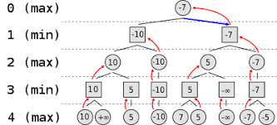
Minimax Algorithm

Slide 6
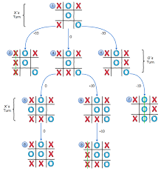
Minimax cont.

Slide 7
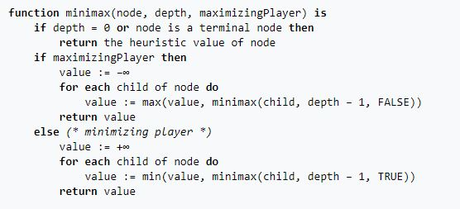
Minimax Pseudocode

Slide 8
Testing
Playing the game!

Slide 9
Testing/Data
From initial Call on Tic-tac-toe
549,946 iterations occur

Slide 10
Demonstration
dextermiller.com

Slide 11
Citations

Slide 12
Questions

